Slide 1
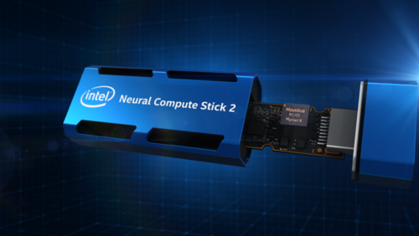
Intel AI Stick
Group 1: Vincenzo Macri, Orlando Pazos, Mikenson Pierre, Orlando Pazos, Emma Rowe, and Michelle Tan

Slide 2

Today Artificial Intelligence issues
The world generates exponential amounts of data daily, and the current Artificial Intelligence (AI) systems are built to analyze and interpret the data. Cloud-based computer systems are not inherent for data security and privacy. Cybersecurity attacks today and soon with quantum computers will change everything OUCH.

Slide 3
Cybersecurity is a severe problem
Cybersecurity is a severe problem.
Military security requirements trump all sharing needs for Cloud, and Distributed Computing exposes Nations, States, and Personal Data to the risks associated with Cloud Based System solutions. Cloud Based client-server networks need large and fast data pipes or bandwidth to make everything work.

Slide 4
How can we merge the Cloud-Based AI to Local independent secure hardware?
Edge Computing technology is needed to move AI tasks to the Edge. The recent migration of AI to the Edge is trending because of local control. We use the intel AI stick, which can solve these problems. Home security systems can use an independent AI stick and download the software to the local computer. Clients can use Neural Network (NN) modules to deploy to various devices. Filtering and keeping data private on local non-cloud-based computers increases processing and performance due to short distances, low latency, and reliability (decentralized, does not depend on network connections). Computer vision and artificial intelligence are pushing and transforming IoT devices to the Edge.
In the market, more and more AI accelerators have come to approve the job. We can build a better ecosystem of AI sticks and cloud-based computation.

Slide 5
Speed and performance
Speed and performance* 1.
Pro’s – Optimized for AI at the Edge The Vision Processing Unit Intel NCS 2 can easily be attached to an Ubuntu LTS 20.04 PC or Raspberry Pi running Raspbian Stretch OS, making it very easy and affordable to get started. Based on the maximum performance of operations per second across all available compute units, the Intel Neural Compute Stick 2 achieves a total performance of over 4 trillion operations per second.
Better security practices and privacy Since the data is collected, users can process it on a local computer without a cloud-based system or internet.

Slide 6
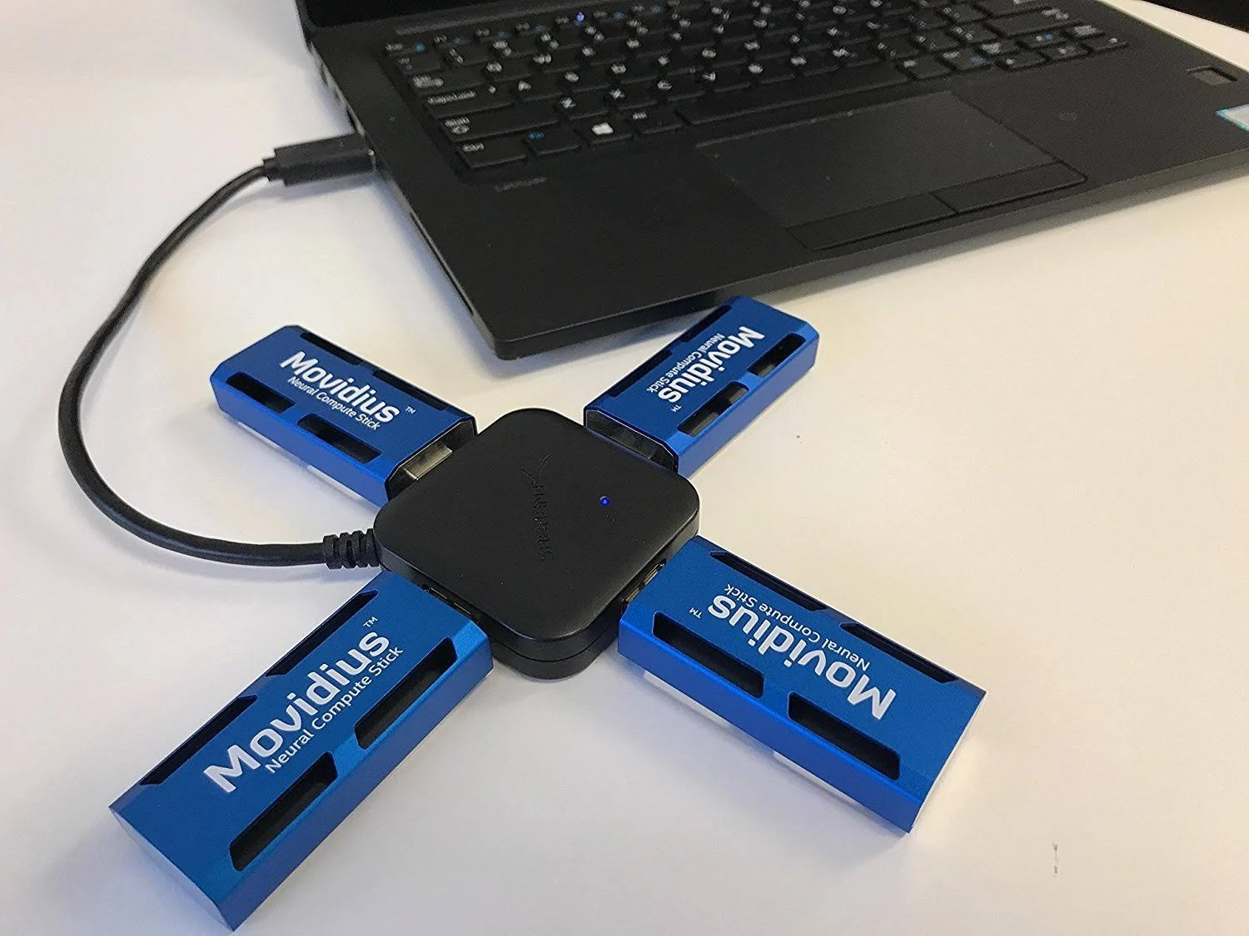
Scalability
Combining multiple NCS 2 sticks is available with distributing the workload between multiple sticks. The use of USB hubs or docking stations to increase the capacity and aggregation of USB ports makes this system expandable.

Slide 7
Flexibility and Reliability
. The 16 vector processors optimize the system for flexibility surrounding computer vision workloads. As a member of the Movidius VPU family, the Movidius Myriad X VPU is known for extremely low, decreased power consumption.”

Slide 8

Reliability
Reliability:
“The NCS is optimized for computer vision tasks with OpenVINO to build Edge AI solutions, where Machine Learning models are executed on-device. Detailed tutorials and instructions make it easy to set up many demos, for example, for real-time object detection.

Slide 9
Resources
https://viso.ai/edge-ai/intel-neural-compute-stick-2
https://www.techproviderzone.com/advanced-technologies/develop-computer-vision-ai-prototypes-with-intel-neural-compute-stick-2
https://newsroom.intel.com/news/intel-unveils-intel-neural-compute-stick-2
https://newsroom.intel.com/news/intel-unveils-neural-compute-engine-movidius-myriad-x-vpu-unleash-ai-edge
https://www.anandtech.com/show/14295/intel-to-discontinue-movidius-neural-compute-stick
Source References:
https://viso.ai/edge-ai/intel-neural-compute-stick-2/

